Slide 1


SOFTWARE TESTING
COMPANY
Here is where your presentation begins

Slide 2
CONTENTS OF THIS TEMPLATE
You can delete this slide when you’re done editing the presentation
Fonts | To view this template correctly in PowerPoint, download and install the fonts we used
Used and alternative resources | An assortment of graphic resources that are suitable for use in this presentation
Thanks slide | You must keep it so that proper credits for our design are given
Colors | All the colors used in this presentation
Icons and infographic resources | These can be used in the template, and their size and color can be edited
Editable presentation theme | You can edit the master slides easily. For more info, click here
For more info: SLIDESGO | BLOG | FAQS
You can visit our sister projects: FREEPIK | FLATICON | STORYSET | WEPIK | VIDEVO

Slide 3
TABLE OF CONTENTS
01
03
02
04
Our company
Our clients
You can describe the topic of the section here
You can describe the topic of the section here
Our services
Expected projection
You can describe the topic of the section here
You can describe the topic of the section here

Slide 4


WHOA!
This can be the part of the presentation where you introduce yourself, write your email…

Slide 5
ABOUT US
You can give a brief description of the topic you want to talk about here. For example, if you want to talk about Mercury, you can say that it’s the smallest planet in the entire Solar System

Slide 6
01
OUR COMPANY
You can enter a subtitle here if you need it

Slide 7
OUR HISTORY
Mercury is the closest planet to the Sun
Jupiter is the biggest planet of them all
2007
2011
01
02
03
04
05
2005
2009
2013
Venus is the second planet from the Sun
Neptune is the farthest planet from the Sun
Despite being red, Mars is actually a very cold place

Slide 8
OUR HISTORY
Mercury is the closest planet to the Sun
Venus is the second planet from the Sun
2015
2019
06
07
08
09
And still going strong!
2017
2021
Despite being red, Mars is a very cold planet
Jupiter is the biggest planet in the Solar System

Slide 9
WHAT WE SPECIALIZE IN?
Do you know what helps you make your point clear?
Lists like this one:
They’re simple
You can organize your ideas clearly
You’ll never forget to buy milk!
And the most important thing: the audience won’t miss the point of your presentation

Slide 10
WHAT ARE OUR ORIGINS?
Our beginnings
Mercury is the closest planet to the Sun and the smallest one in the entire Solar System.” This planet's name has nothing to do with the liquid metal, since Mercury was named after the Roman messenger god. Despite being closer to the Sun than Venus, its temperatures aren't as terribly hot as that planet's. Its surface is quite similar to that of Earth's Moon, which means there are a lot of craters and plains. Speaking of craters, many of them were named after artists or authors who made significant contributions to their respective fields. Mercury takes a little more than 58 days to complete its rotation so try to imagine how long days must be there!
2005
Venus is the second planet from the Sun

Slide 11
OUR PHILOSOPHY
Vision
Jupiter is a gas giant and the biggest planet in the Solar System. It’s also the fourth -brightest object in the night sky
Mission
Values
Despite being red, Mars is actually a very cold place. It’s full of iron oxide dust, which gives the planet its reddish cast
Venus has a beautiful name and is the second planet from the Sun. Venus is terribly hot, even hotter than Mercury

Slide 12
—SOMEONE FAMOUS
“This is a quote. Words full of wisdom that someone important said and can make the reader get inspired.”

Slide 13
OUR STRENGTH
Loyalty
Efficiency
Mercury is the closest planet to the Sun
Jupiter is the biggest planet of them all
Reliability
Commitment
Specialization
Venus is the second planet from the Sun
Neptune is the farthest planet from the Sun
Despite being red, Mars is actually a very cold place

Slide 14
02
OUR SERVICES
You can enter a subtitle here if you need it

Slide 15

OUR SERVICES
Full-cycle testing services
Quality engineering
Mercury is the closest planet to the Sun
Venus is the second planet from the Sun
Complete test coverage
System and platforms
Despite being red, Mars is actually a very cold place
Jupiter is the biggest planet of them all

Slide 16
BEST SELLERS
01 | Jackson Robson | Atlanta | 250 new clients
02 | Dianne Voghel | Brudge | 230 new clients
03 | Jorge López | Barcelona | 178 new clients

Slide 17
AWESOME WORDS

Slide 18
OUR CLIENTS
03
You can enter a subtitle here if you need it

Slide 19
TARGET
Group
Interests
60% Big companies and banks
Jupiter is a gas giant and the biggest planet in the Solar System
Earth is the third planet from the Sun and where we all live
100%
Security
Agility
70%
40% Small and familiar companies
Friendly
50%
Mercury is the closest planet to the Sun and the smallest of them all
Simple
30%

Slide 20
SOME CLIENTS AROUND THE WORLD
800+ clients
Mercury is the closest planet to the Sun

Slide 21
CUSTOMER TESTIMONIAL
Dianne Smith
Chris López
“Mercury is the closest planet to the Sun”
“Jupiter is the biggest planet of them all”
Johanna Robs
Jose Pereyra
“Venus is the second planet from the Sun”
“Saturn is composed mostly of hydrogen and helium”
John Tomas
Andrea Pardo
“Neptune is the farthest planet from the Sun”
“Despite being red, Mars is actually a cold place”

Slide 22
OUR NUMBERS
$200M
18 years
TO 800
Value in the market
Experience in the sector
Clients around the world

Slide 23
04
EXPECTED PROJECTION
You can enter a subtitle here if you need it

Slide 24
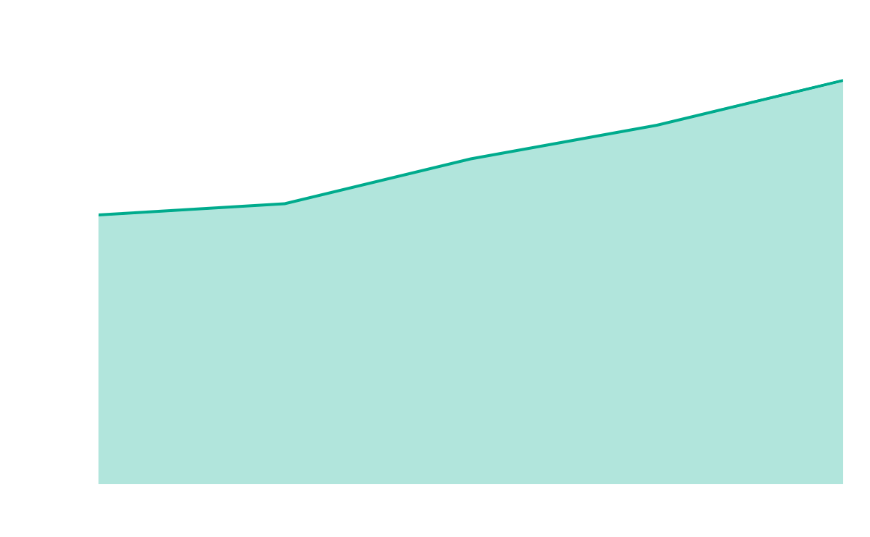
OUR GROWTH
$20,000
Expected income from 202X
150
New employees next year
Follow the link in the graph to modify its data and then paste the new one here. For more info, click here

Slide 25
A PICTURE ALWAYS REINFORCES
THE CONCEPT
Images reveal large amounts of data, so remember: use an image instead of a long text. Your audience will appreciate it

Slide 26
OUR AWARDS
2017
2019
2021
Mercury is the closest planet to the Sun
Venus is the second planet from the Sun
Neptune is the farthest planet from the Sun

Slide 27
250
Projection of new clients next year

Slide 28

FUTURE PROJECTS
Project 1
01
02
Project 2
Mercury is the closest planet to the Sun
Venus is the second planet from the Sun
Project 3
Project 4
03
04
Despite being red, Mars is actually a very cold place
Jupiter is the biggest planet of them all

Slide 29
OUR TEAM
Marie Robson
You can speak a bit about this person here
Joshua Do
You can speak a bit about this person here

Slide 30
Desktop demo
You can replace the image on the screen with your own work. Just right-click on it and select “Replace image”

Slide 31
Tablet demo
You can replace the image on the screen with your own work. Just right-click on it and select “Replace image”

Slide 32
Mobile demo
You can replace the image on the screen with your own work. Just right-click on it and select “Replace image”

Slide 33
THANKS!
Do you have any questions?
youremail@freepik.com
+91 620 421 838
yourcompany.com
Please keep this slide for attribution

